Slide 1
OS-Related Hardware

Slide 2
Overview
Recall that OS manages h/w resources
Provides virtualization mechanism for sharing resources
Provides systems calls for abstracting h/w
OS is software, when other applications are running, it is not running, so how does it manage resources?
Why can’t applications corrupt other applications or the OS?
Virtualization is broken
Why can’t applications directly access h/w?
Hardware abstraction is broken
OS needs help from hardware

Slide 3
Hardware Support for OS
OS uses three hardware features
CPU modes
Memory management
Trap

Slide 4
CPU Modes
CPUs have two modes: kernel, user
When CPU is in kernel mode, every instruction can be executed
When CPU is in user mode, only a subset of instructions can be executed
CPU maintains current mode in its status register
Typical instructions: add, sub, push, pop, etc.
User mode
instructions
Privileged
instructions
Allow accessing devices such as disk and timer (io instructions), controlling interrupts, setting CPU mode
CPU instruction set
Notes:
As we will see, when programs (running in use mode) call privileged instructions, the processor will not run the instruction. Instead it will trap, which causes the CPU to switch to kernel mode, and the OS will then regain control.

Slide 5
OS Runs in Kernel Mode
OS runs in kernel mode
Has all privileges, access to all memory, devices, etc.
When h/w boots, it runs in kernel mode
OS code starts running
OS ensures that programs run in user mode only
So programs have limited privileges
No direct access to devices, limited memory access
When programs need access to device, they MUST call OS
OS is a privileged, trusted program
Correct system operation depends on correct OS design and implementation, but not on correct user programs
Notes:
Recall that devices are programmed using IO instructions. These instructions are privileged.
We will see later how memory management h/w limits memory access.

Slide 6
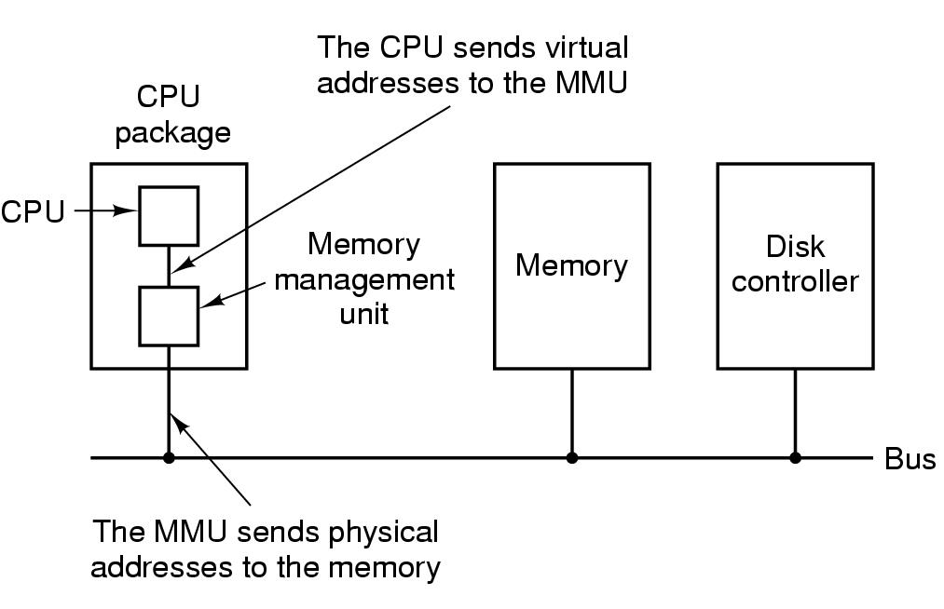
Memory Management Unit
How does the CPU run multiple programs using the same memory addresses simultaneously? Recall mem.c
CPU has a Memory Management Unit (MMU)
2. CPU sends these virtual
addresses to MMU
1. Programs use virtual
memory addresses
3. MMU translates virtual address to physical memory address
4. MMU accesses memory using physical addresses

Slide 7
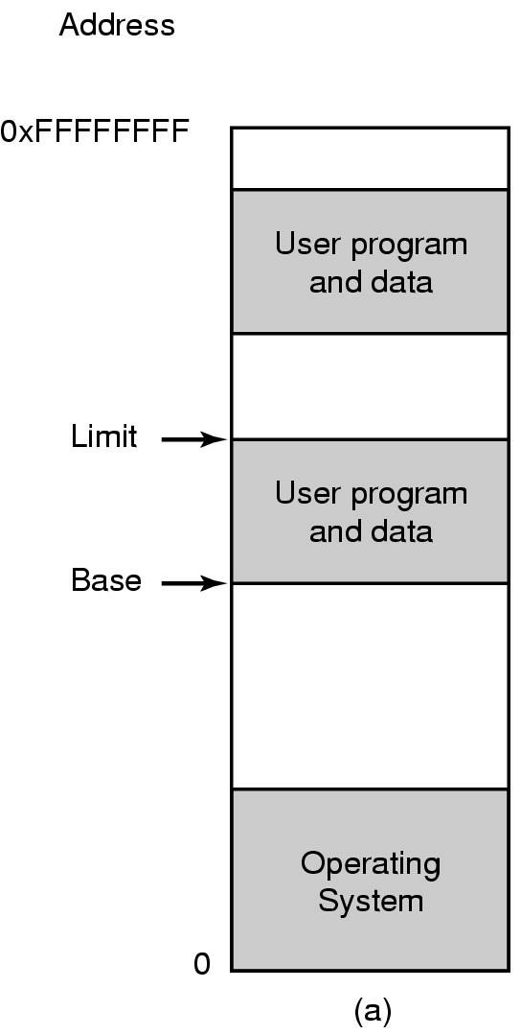
A Simple MMU
A simple MMU has one base register and one limit register
MMU converts virt to phys address:
Phys Addr = Virt Addr + Base register
Limit register bounds memory references
Virt Addr < Limit register
Say program P1 is running
Base reg = Base 1
Limit reg = Limit 1 (relative to Base 1)
When P1 reads data at virt addr 0, data at phys addr Base 1 is returned
Limit 2
P2
Base 2
Limit 1
P1
Base 1

Slide 8
OS and MMU
Let’s see how an MMU allows two programs to use the same memory address simultaneously
OS sets base, limit register to different values when a different program starts running
When P2 starts running, OS sets
base = Base 2, limit = Limit 2
Questions:
How does MMU enable memory virtualization?
How does OS enable memory isolation?
Can programs change MMU registers?
Limit 2
P2
Base 2
Limit 1
P1
Base 1
Notes:
Memory virtualization: Recall that with memory virtualization each program has access to a large amount of contiguous, private memory, starting at address 0. The MMU enables exactly that.
Memory isolation: The OS ensures that its own code+data, and the different programs are located in different (non-overlapping) physical memory registers. Using the MMU, the OS can limit memory accesses of regular programs (each program can access physical memory within its own base and limit values), and ensure that programs cannot step on each other’s memory or the OS memory.
Changing the MMU register values must be privileged operations, or else a program could change the MMU register values and access any physical memory.

Slide 9
Trap
Programs run in user mode, so they can’t access devices directly, e.g., read disk
IO instructions are privileged
OS ensures that devices are mapped to kernel memory, which cannot be accessed by programs
So how can a program access a device?
It needs to run OS code
Can a program call OS code directly?
H/W provides trap instruction to switch to kernel mode and run OS code
Notes:
Call OS code directly: no, OS code is isolated using MMU. Even if it was not isolated, OS code needs to run in kernel mode (because it accesses devices), and so we need some way to go to kernel mode.

Slide 10
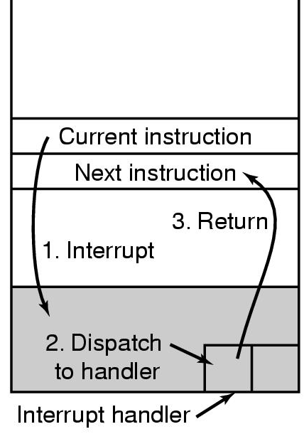
Trap
CPU handles trap instruction similar to interrupts
Current instruction is trap instruction
On trap (hardware)
CPU switches to kernel mode
Runs OS handler code at well-defined location
OS handler code (software)
Saves processor state
Runs kernel functions to access h/w
Restores processor state
Returns to user code, switches to user mode
Notes:
The switch to kernel mode and running OS handler code has to occur atomically, i.e., no other instructions can run in between, or else user code may be able to run in kernel mode. Similarly for returning to user code, and switching to user mode.
what kind of kernel functions are run: these are the functions that implement system call functionality

Slide 11
System Call
Programs request h/w access via system calls
Unix system calls
Process related: fork, exec, wait, exit, kill, signal
File related: open, read, write, close, link, unlink, chdir
code runs in user mode
Program1 Library
code runs in kernel mode
read
return results
OS Kernel
trap
Hardware

Slide 12
Invoking System Call
usercode() { // program code
...
read(file, buffer, n);
...
}
read(file, buff, n) { // library code
...
lw a2, 12(sp) /* load n */
lw a1, 8(sp) /* load buffer */
lw a0, 4(sp) /* load file */
lw v0, SYS_read /* load syscall nr. into v0 reg */
/* nr. indexes into syscall table */
syscall /* trap instruction */
... /* v0 reg has return value */
}
Notes:
lw is load word
a0, a1 and a2 are general purpose registers on MIPS architecture, they are used to load the arguments of read
You can use the debugger to see the assembly for a simple system call such as read. Do demo in class using code-examples/intro/read.c

Slide 13
Traps, Interrupts, Exceptions
 | Interrupt | Trap | Exception
Cause | H/W external to CPU | Explicit instruction | Instruction failure, e.g., divide by zero, bad memory access
Effect | None, program is unaware that interrupt, or interrupt handling occurred | Appears like program invoked (system call) function, and function returns data | Abnormal control flow
Timeliness | OS needs to respond to external event quickly | OS can take time to respond, since program is suspended | OS can take time to respond

Slide 14
Virtual Machine Interface
Application layer
virtual machine interface = user mode instructions + OS interface
OS interface = set of system calls
OS Kernel
physical machine interface
Hardware layer
privileged
instructions
user-mode
instructions
Notes:
Note that the trap instruction is a user mode instruction since programs running in user mode invoke it to run kernel code.

Slide 15
Quick Review
How does OS manage h/w?
OS is software, when other applications are running, it is not running, so how can it do its work?
Why can’t applications corrupt other applications or the OS?
Why can’t applications directly access h/w?
Notes:
How does OS manage h/w: virtualizes h/w, abstracts h/w
how can it do its work: uses h/w support, in the form of kernel mode, MMU and traps
can’t corrupt apps or OS: MMU
directly access h/w: For memory-mapped devices, OS ensures that the device is mapped into kernel memory, and the OS ensures via the MMU that programs cannot access kernel memory. For devices that are programmed using IO instructions, these instructions are privileged.

Slide 16
Summary
OS manages h/w
Virtualizes h/w
Abstracts h/w
Implementing this functionality efficiently and securely requires h/w support
CPU modes: enable running programs with limited privileges, so that they do not have full access to h/w
MMU: helps provide memory isolation
Trap: provides a secure way to enter the kernel, enables programs to access devices and OS services via system calls (OS API)
Notes:
Efficiently: one could have an interpreter/simulator that interprets every instruction and provides h/w virtualization and abstraction, but this would be very slow.
Securely: The h/w support is needed to ensure that programs do not corrupt the OS or other programs, think about how each of the three (CPU mode, MMU and trap) help with this.

Slide 17
Think Time
Why is the OS not a normal program?
What if a program tries to cheat?
What happens if it issues a privileged instruction directly?
What if a running thread doesn’t make a system call to the OS and hence hogs the CPU?
What stops the running program from disabling an interrupt?
What stops a program from modifying the OS so that the OS runs user code?
What stops a program from changing the MMU registers?
Notes:
OS not a normal program: various answers, including:
It is "entered" from different locations (system calls and interrupts) in response to external events
It does not have a single thread of control, it can be invoked simultaneously by two different events (e.g. system call & an interrupt)
It is not supposed to terminate
It can execute any instruction in the machine
It has access to the entire memory on the machine
privileged instruction directly: Attempting execution of privileged instruction in user mode causes trap, so kernel gets control. Normally, kernel will kill program.
thread doesn’t make system call:
OS needs interrupts from a timer device
OS must register a future timer interrupt before it hands control of the CPU over to a thread
When the timer interrupt goes off, the OS gets control
Disabling interrupts is a privileged instruction
Modifying OS: MMU provides memory isolation, so program cannot see, let alone modify OS code
Modifying MMU registers must be a privileged operation

Slide 18
Think Time
How does the OS solve these problems:
Time sharing the CPU among programs?
Space sharing memory among programs?
Protection of programs from each other?
Protection of hardware/devices?
Protection of the OS itself?
Does library code (executing in user mode) provide isolation and abstraction?
Does a virtual machine monitor (VMM) such as VMware provide isolation and abstraction?
Notes:
Time sharing - uses timer interrupts to ensure that all programs get to run
Space sharing - Uses MMU to setup memory for programs and to ensure that programs don't corrupt each other
Protection - The two things above
Protection of h/w – For memory-mapped devices, OS ensures that the device is mapped into kernel memory, and the OS ensures via the MMU that programs cannot access kernel memory. Also, IO instructions are privileged.
Protection of OS - Uses MMU to ensure that OS memory cannot be accessed in user mode
Library code can provide abstraction but it doesn’t provide isolation. Programs can jump to any instruction in library code, overwrite library code/data, thus bypassing any isolation that library code may try to provide.
a VMM is a system program, similar to an OS, that allows multiple operating systems to run simultaneously on a single physical machine. It provides isolation, but the same abstraction as a physical machine (each OS thinks it is running on physical hardware), thus providing no additional abstraction than the physical machine.

Slide 19
Think Time
Why can’t user code execute some arbitrary code of its choosing in kernel mode?
What is the minimum number of privileged instructions that h/w must implement so that the OS can work correctly?
Notes:
User code wants to execute some code in kernel mode, so what can it do?
Write instructions into kernel image - can’t do that due to memory protection.
Transfer control to arbitrary places in kernel image to skip checks - can’t do this due to memory protection, and control can only be transferred via TRAP to well known kernel entry locations.
Execute privileged instructions - can’t do this in user mode.
Minimum nr. of instructions: with memory mapped IO, you can hide all device accesses with memory protection. So programming the MMU (i.e., modify MMU registers) should be privileged. Also, returning from a trap (e.g., iret instruction) should ensure that we cannot switch from user to kernel mode and run arbitrary kernel code. For example, on x86, a return from trap is guaranteed to execute code with the same or lower privilege level.

